Slide 1


iFood
Analyze & drawing conclusions from the data

Slide 2
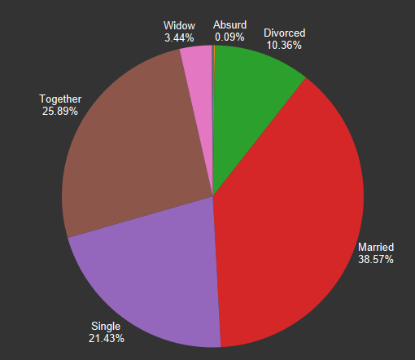
People of Which marital status are our most regular & loyal customer?
The above pie chart shows that Married, Single and Together people have ordered the most and are responsible for the majority of the revenue generated by our company. These three different categories combined account for more than 80% of the total orders.

Slide 3
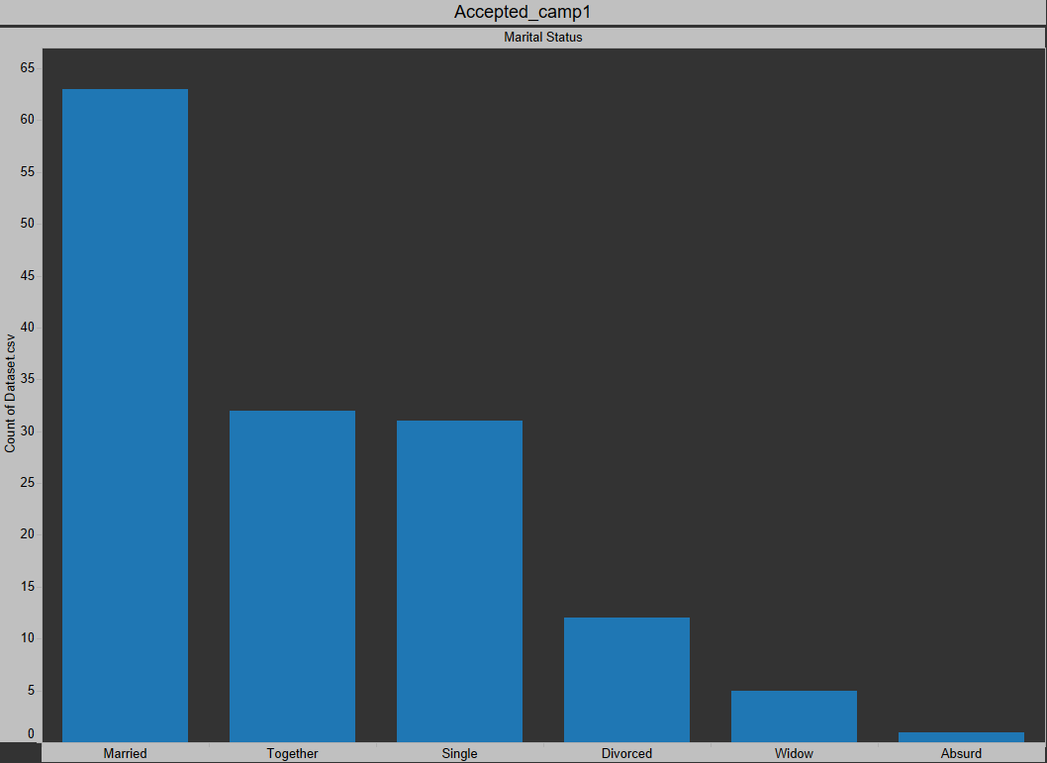
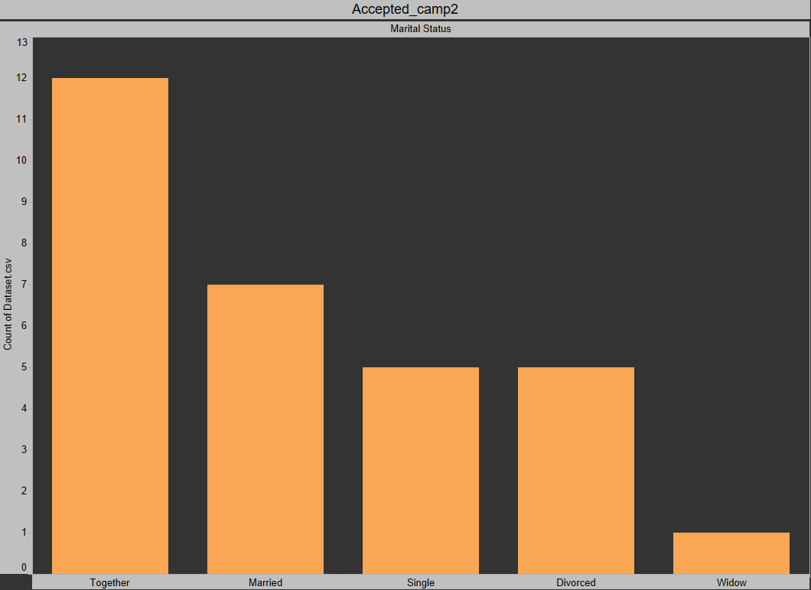
Who accepted the most offers in 1st & 2nd Campaign?
In both the campaigns, Married and Together people have accepted the majority of the offers. But, in the first campaign more than 140 people accepted the offers, while in the second campaign very few people accepted the offers i.e. just 30.

Slide 4
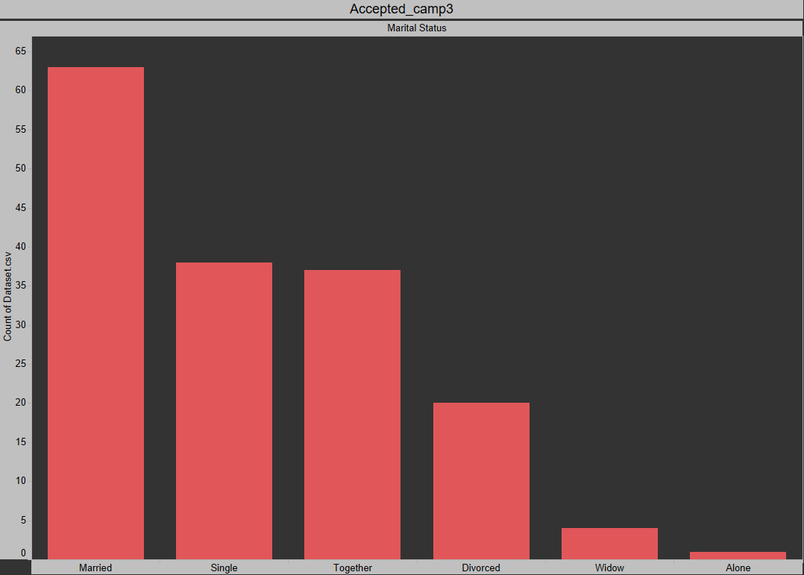
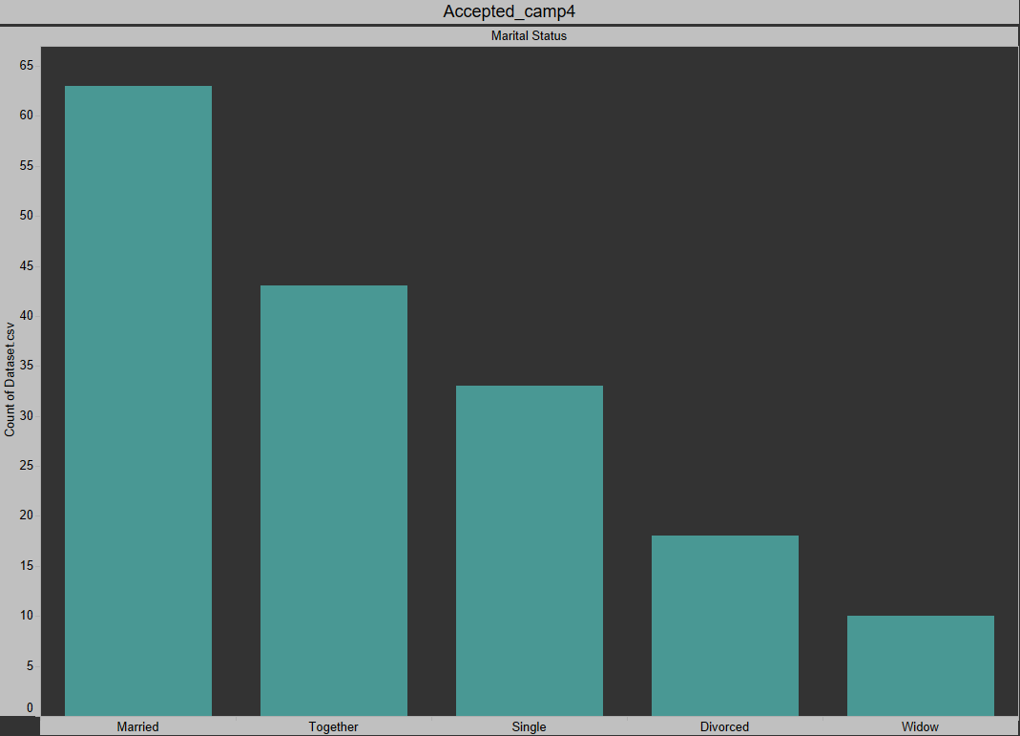
Who accepted the most offers in 3rd & 4th Campaign?
In the third campaign, Married and Single people have accepted the majority of the offers, while in the fourth campaign Married and together people have accepted the most offers. Both third and fourth campaigns received the similar responses in terms of the total accepted offers

Slide 5
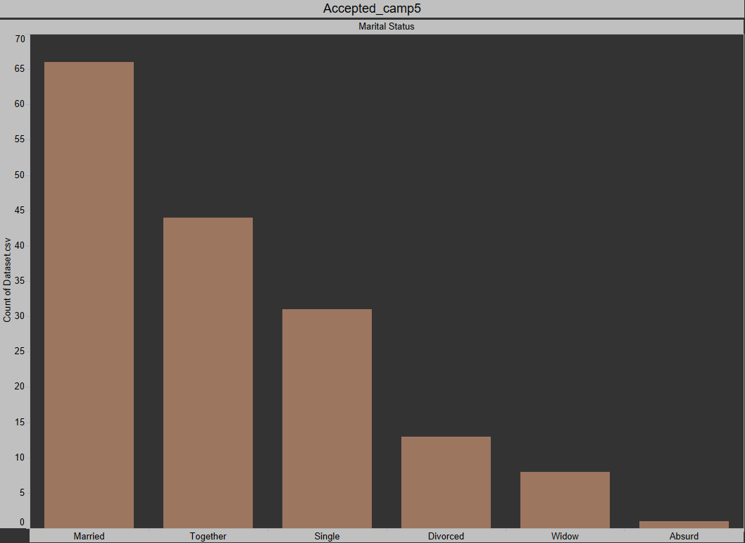
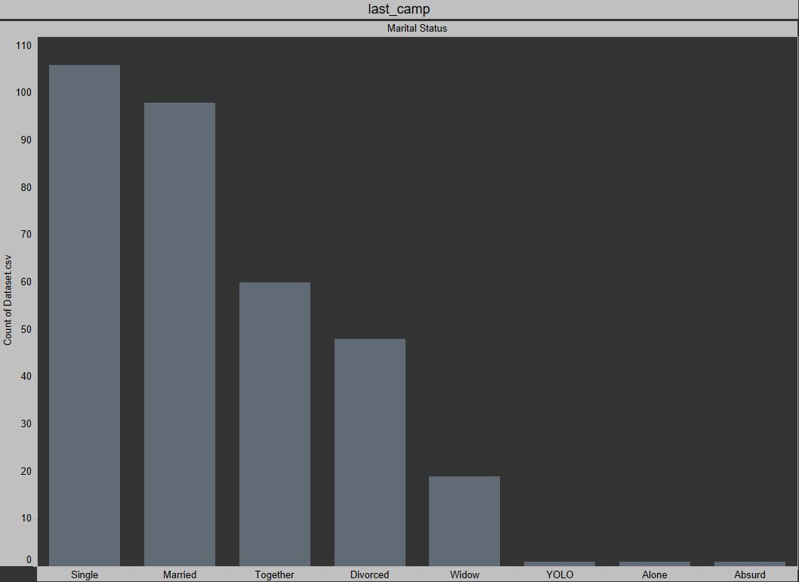
Who accepted the most offers in 5th & last Campaign?
In the Fifth campaign, Married and Together people have accepted the majority of the offers, while in the last campaign Single, Married and together people have accepted the most offers. Both the campaigns received the similar responses (Huge) in terms of the total accepted offers.

Slide 6
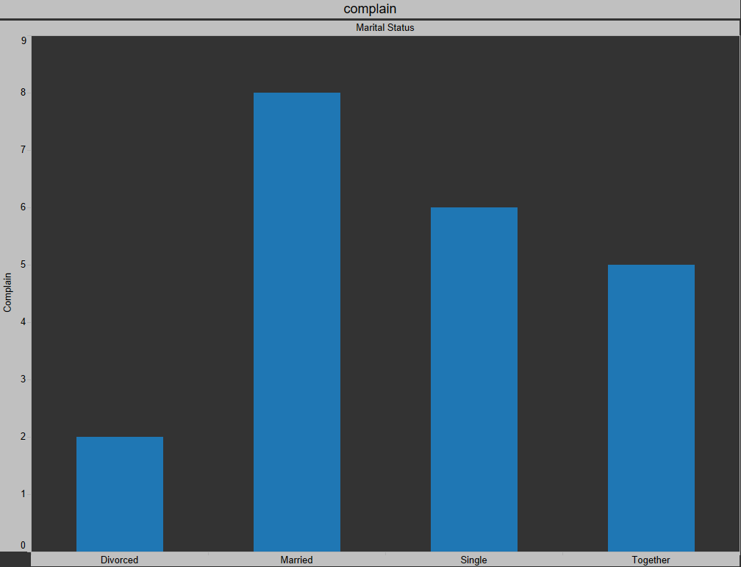
Explanation!
The respective Bar chart shows the complaints registered by the people of different Marital statutses such as Married, Divorced, etc.
Apparently, only Divorced, Married, Single and Together people found something wrong with their items and registered any complaints. Moreover, Married, single, and together people have registered the most complaints.
But, we have seen in the above slides that people of the same marital status i.e. Married, Together have ordered the most.
So, it shows that complains have nothing to do with accepting the campaigns. They have no co-relation.

Slide 7
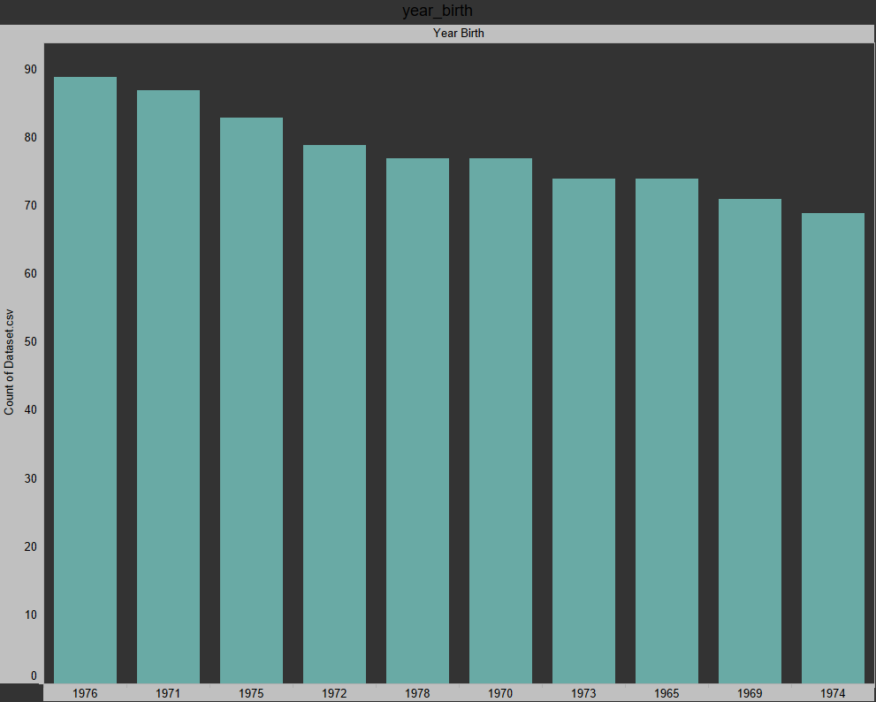
Top 10 years in which majority of our customers were born
The majority of our customers were born in 1970s. We can see from the above bar chart that 8 out of the 10 years are from 1970s. We can treat them as our exclusive customers as they are huge in numbers.

Slide 8
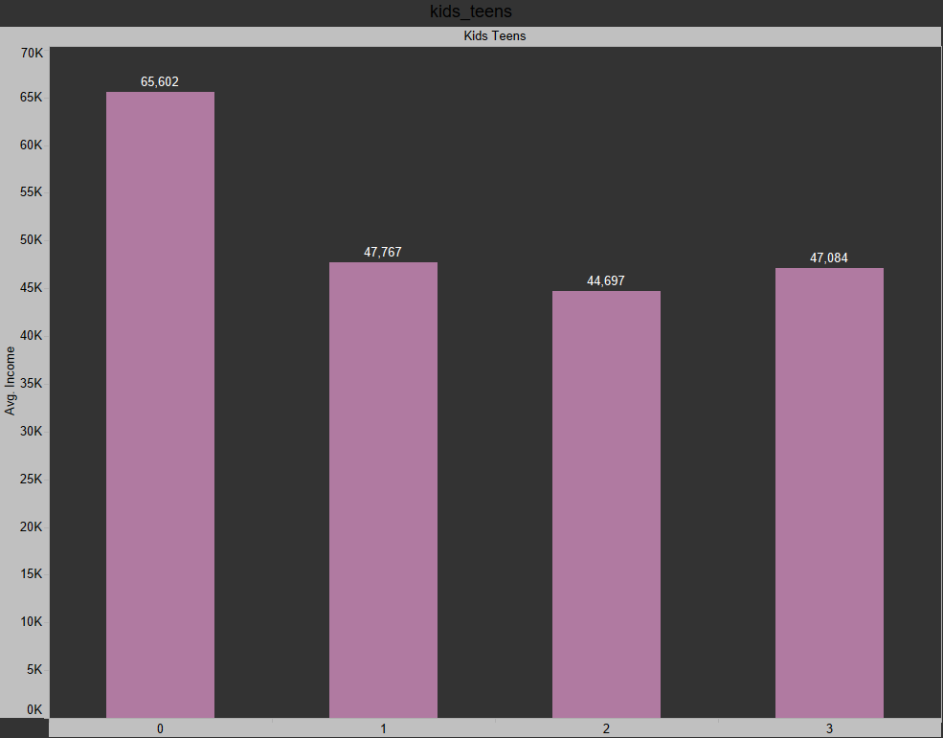
How much does the avg. income of the family vary with the number of kids&teens in the family?
The family that has the least number of kids&teens earn the most. As the number of kids&teens increases in the family, the avg. income of the family decreases. While analyzing the data, we also found out that the family with the least number of kids&teens order the most as they have very high avg. income. So they are able to spend on the food items easily

Slide 9
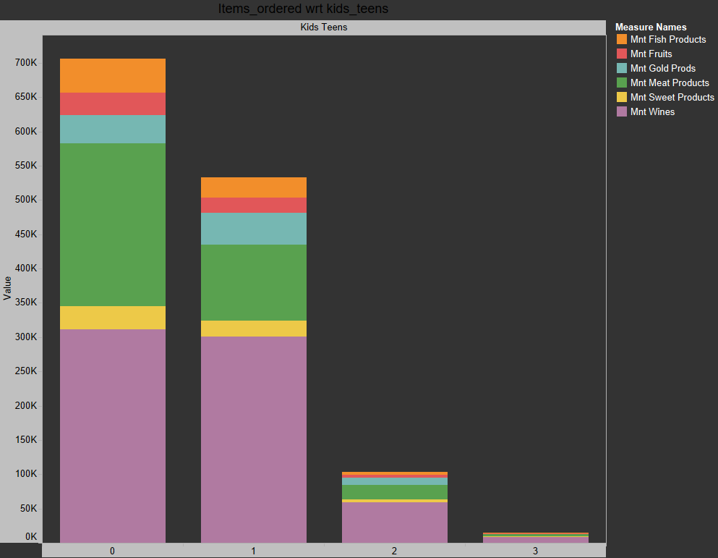
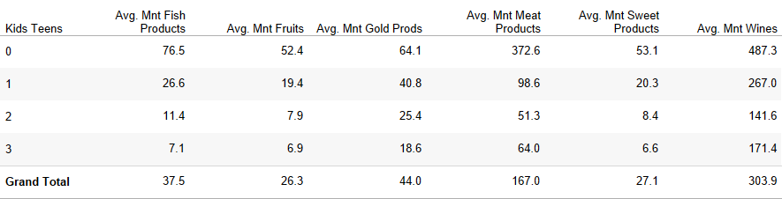
Products ordered V/S no. of kids_teens
The respective Bar chart shows the number of products ordered by the family having different number of kids&teens.
The family with no kids&teens order the most and family with the most(3) number of kids&teens order the least. Because, avg. income of the family decreases with the increase in number of kids&teens in them.
After analyzing the croostab in the bottom right corner, we can say that the families love spending more on wines & meat products than the rest of the products.
So, we must focus wisely on our products and offers we provide.

Slide 10
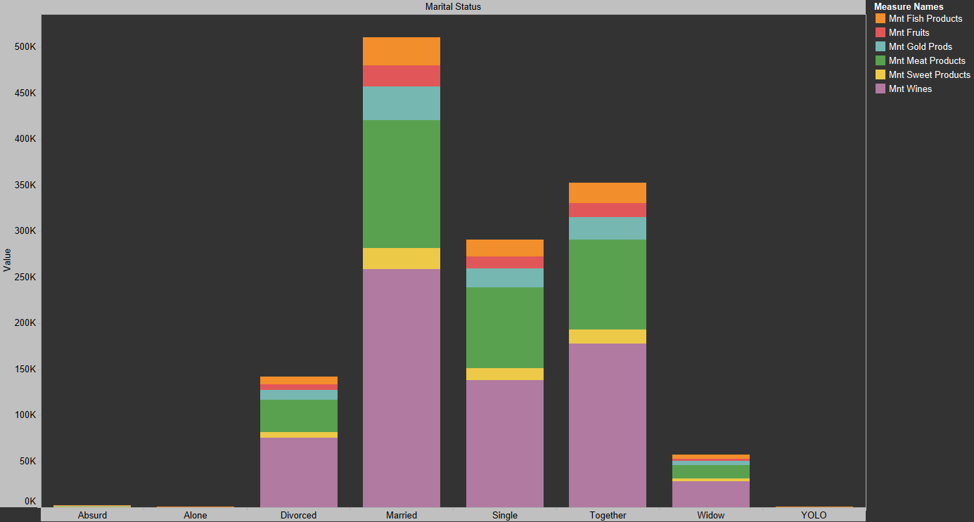
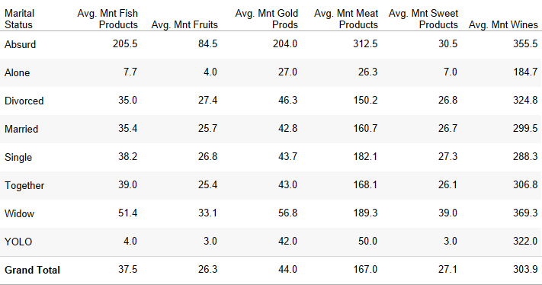
Products ordered V/S different categories of people
Again, we can say that Fish products and Wines are our most selling products. Married, single, together and Divorced are our four of the most regular and important customer base. We must focus on them even more and give more offers on the products that they most often buy.

Slide 11
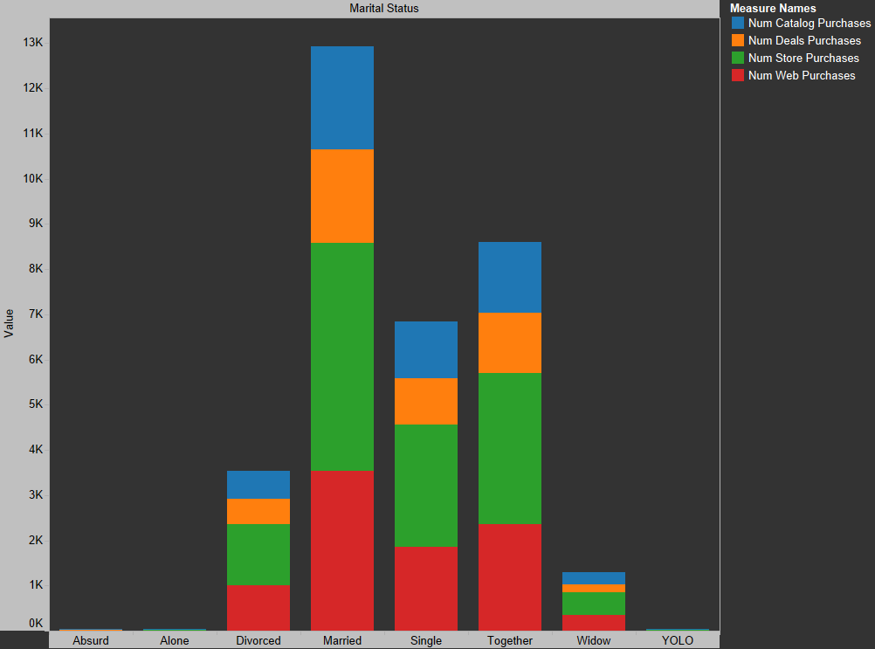
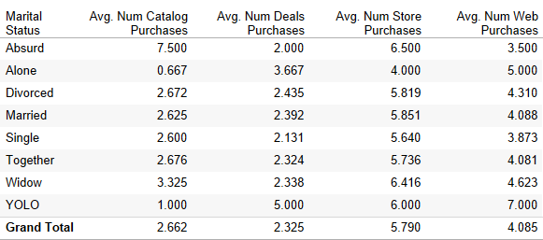
Which platform do our customers access the most?
The respective Bar chart shows that people are buying the most from Store and web, while least from Catalog.
So, we could say that our web and in-store purchasing services are used more often.
Hence, we should start focusing more on those two services and work upon improving them even more.
Or else, we could provide more coupons on Catalog purchases to boost our Catalog purchases.
For the long term, we must work upon all the platforms equally as all the platforms combined can increase our revenue manifolds.

Slide 12
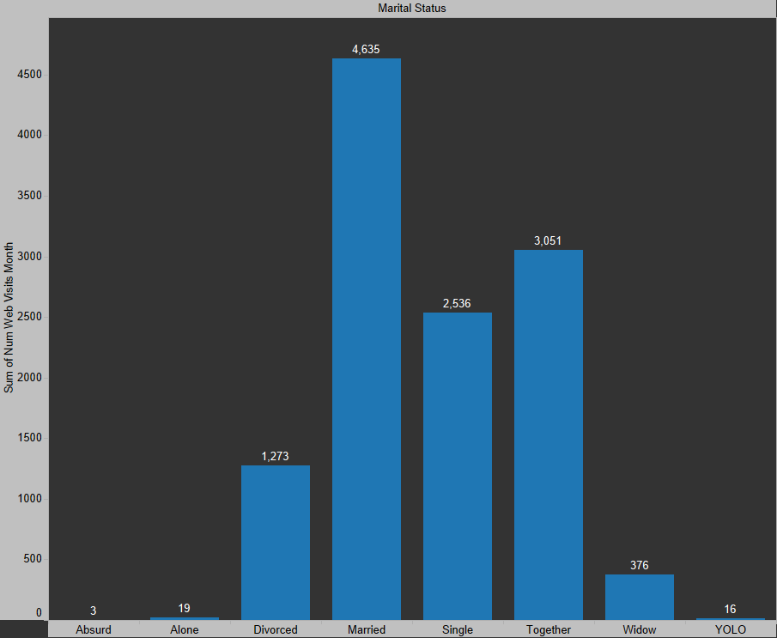
Who visited our company’s website the most in that past 2 months?
Married, Single and Together people have visited the company's website the most in the past couple of months. And to attract Alone, YOLO, Divorced, and Widow people, we must give them more coupons on the things that they buy the most. Like Meat, wine, etc

Slide 13
Thank You

